Slide 1
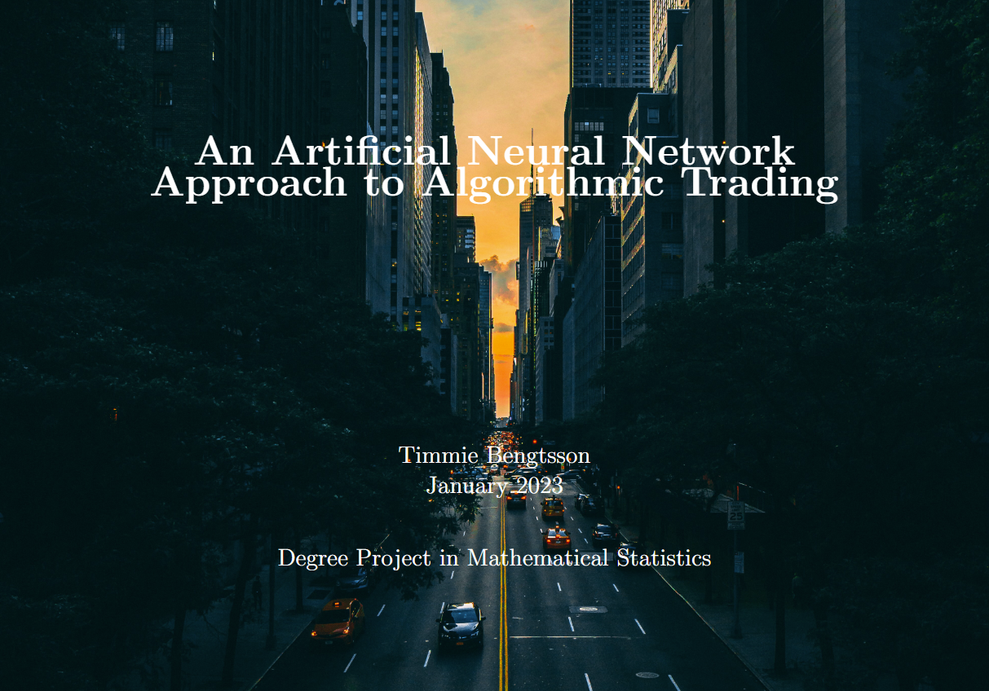

Slide 2

Background
Machine learning & computational power advancements
Financial sector usage of machine learning
Training algorithms on historical data – pattern finding
Sucessful price prediction challenges the Efficient Market Hypothesis (EMH)
EHM empirically proved wrong by multiple hedge funds

Slide 3
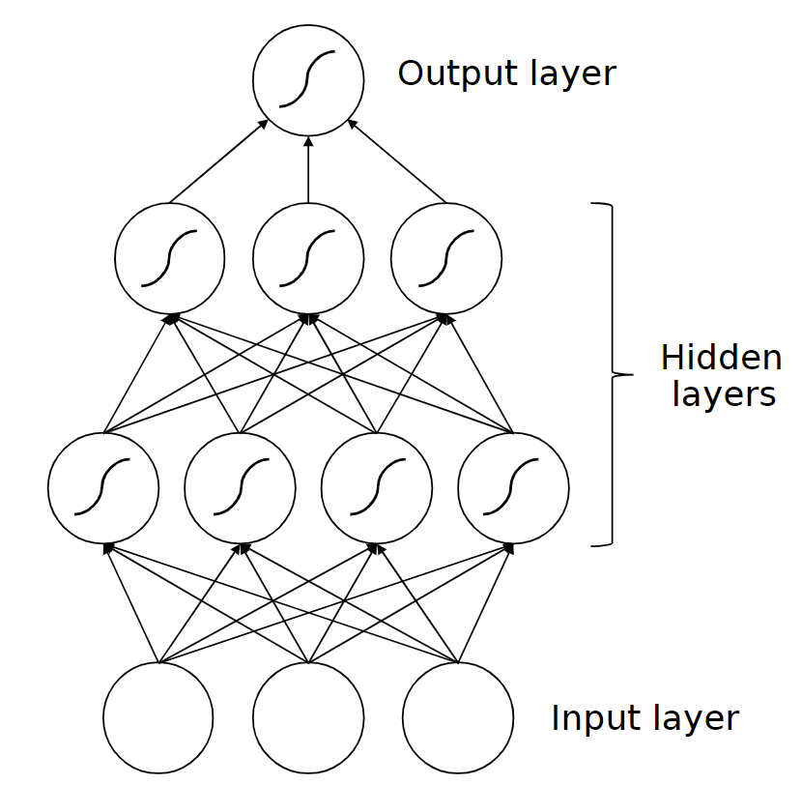
This thesis
Construct and asses neural network models for use in algorithmic trading
Given historical returns, the models are trained to forecast the direction of asset price returns the following day
The performance of these models is then benchmarked against naive trading strategies and the underlying asset itself
The thesis has been done in collaboration with Handelsbanken Fonder

Slide 4
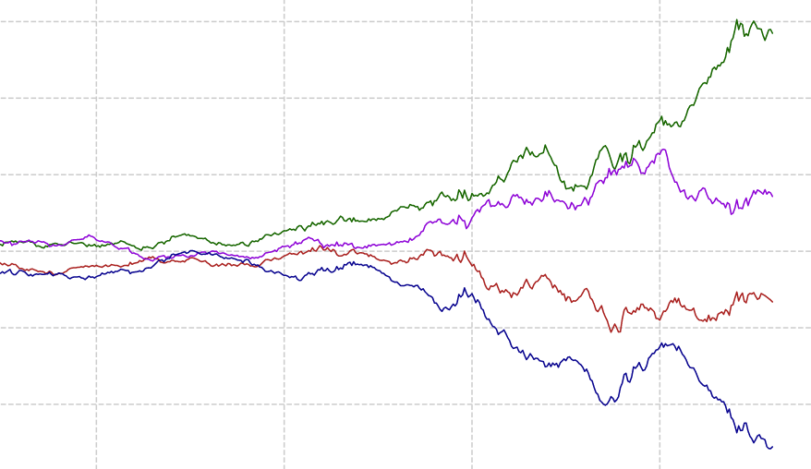
Setup
Long / Short positions in a single asset
Trades taken based on the output of a neural network
LSTM and GRU nodes
Benchmarking
Simple models, AR(1) and AR(10)
AR(1) = ”Naive”
AR(10) = ”Trend”

Slide 5
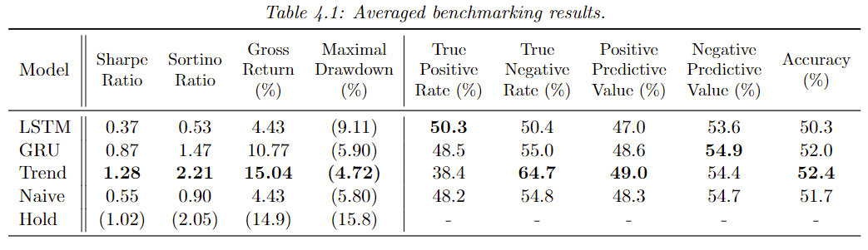
Results – benchmarking
Below table displays averaged benchmarking results for each model
The Trend model performs best, followed by the GRU model

Slide 6
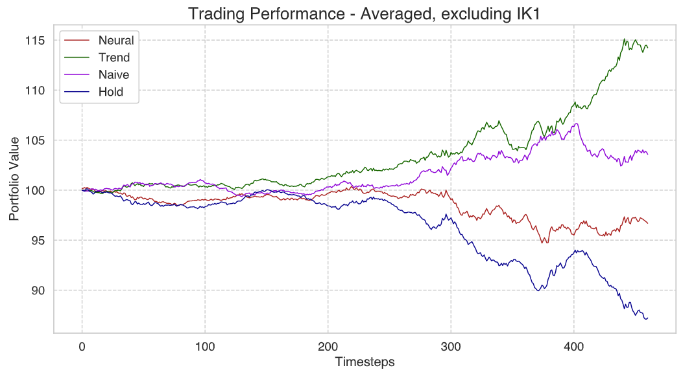
Results – trading performance, LSTM
The Trend model performs the best followed by the naive model

Slide 7
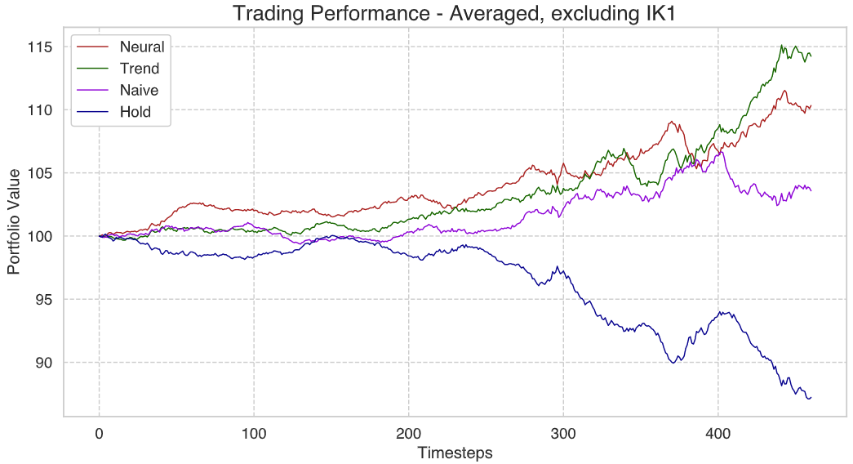
Results – trading performance, GRU
The Trend model performs the best followed by the neural (GRU) model

Slide 8
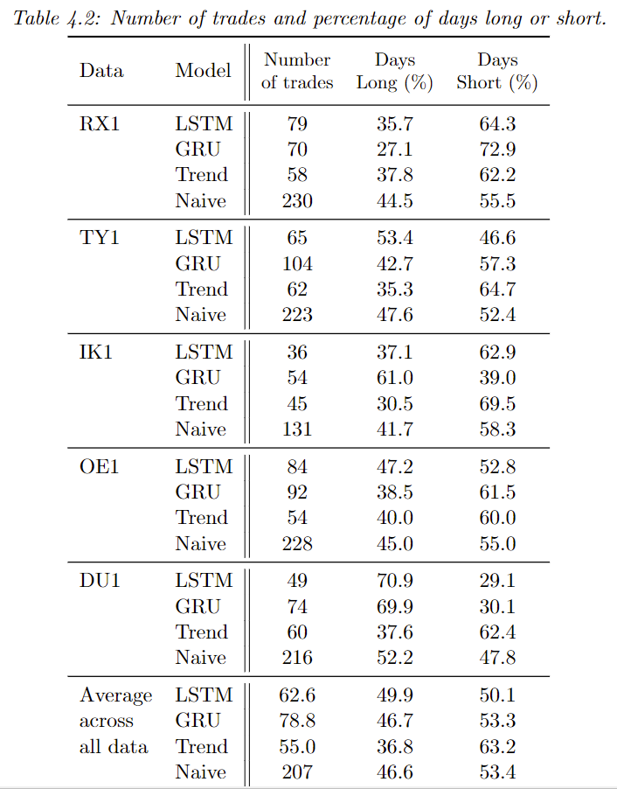
Results – days long vs short
The Trend model took the least number of trades
The number of long and short days are almost the same for the LSTM, GRU, and Naive models
The Trend models held on average a short position 63% of the days

Slide 9
Conclusion & Discussion
No definitive conclusions can be drawn regarding the efficacy
Generalization beyond the specific models and time series examined here is challenging
With the appropriate design, an ANN model could produce a trading algorithm that outperforms benchmark models
The trend models great perfromance might be circumstantial
The trend model held a short position 63% of the days
Very poor performance from the LSTM models

